Slide 1
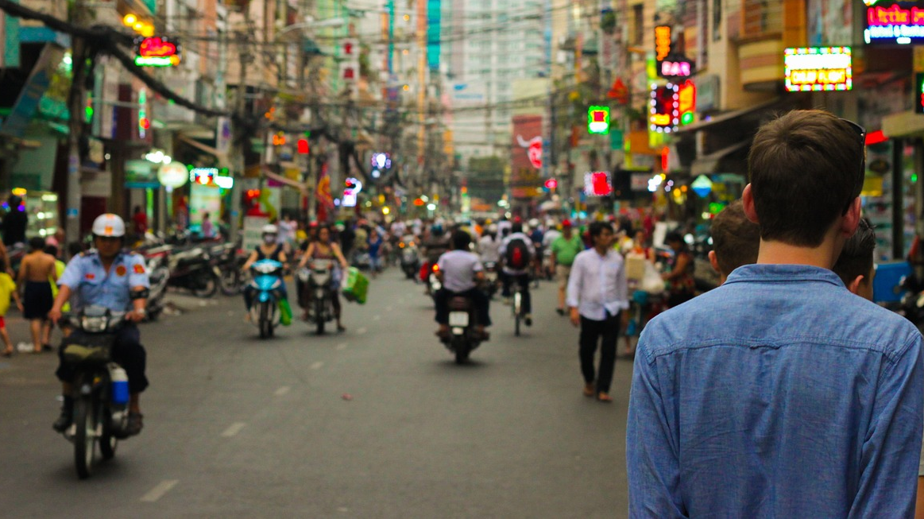
God and Man
Through the Bible Series
Part 7: Plagues & Passover

Slide 2
God & Man Through The Bible Series
Session 1 Introduction to the Bible
Old Testament
Session 2 Creation
Session 3 The Fall of Man
Session 4 The Flood
Session 5 The Tower of Babel/Abraham
Session 6 Joseph and Egypt
Session 7 The Plagues & Passover
Session 8 The Ten Commandments
Session 9 Saul; David & The Kings of Israel
Session 10 The Temple & The Prophets

Slide 3
Abraham’s Descendants
Abraham had a son called Isaac. One of Isaac’s sons was called Jacob.
Although Jacob was a cheat and a trickster, he eventually became a follower of God.
Jacob had 12 sons by four different women. They were named: Reuben, Simeon, Levi, Judah, Dan, Naphtali, Gad, Asher, Issachar, Zebulun, Joseph and Benjamin.
Their descendants later became the 12 tribes of Israel.

Slide 4
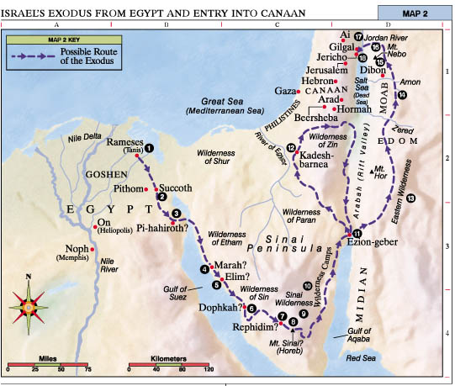
Introduction: From Abraham to Moses (Genesis 37-50)
Abraham’s son was Isaac; Isaac’s son was Jacob (Israel)
Jacob had 12 sons. One – Joseph – was sold as a slave but eventually became the prime minister of Egypt.
During a famine, Jacob and the rest of the family joined Joseph in Egypt.
The Jewish people multiplied but a later pharaoh (king) of Egypt used them as slaves. Eventually they escaped.

Slide 5
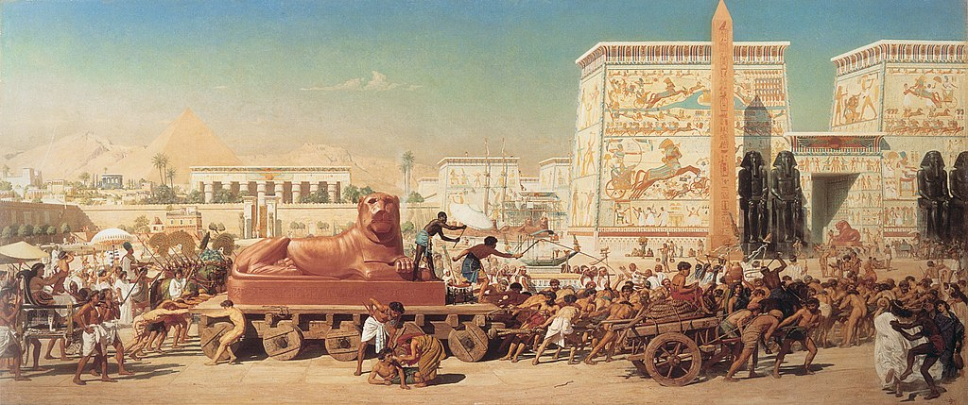
Introduction: From Abraham to Moses (Exodus 1)
Israel in Egypt by Edward Poynter
The Israelites stayed in Egypt for 430 years and became a nation of about 600,000 adult men - plus women and children.
A new pharaoh commanded the Israelite midwives kill any Israelite baby boys born (but the midwives refused to obey the command)

Slide 6
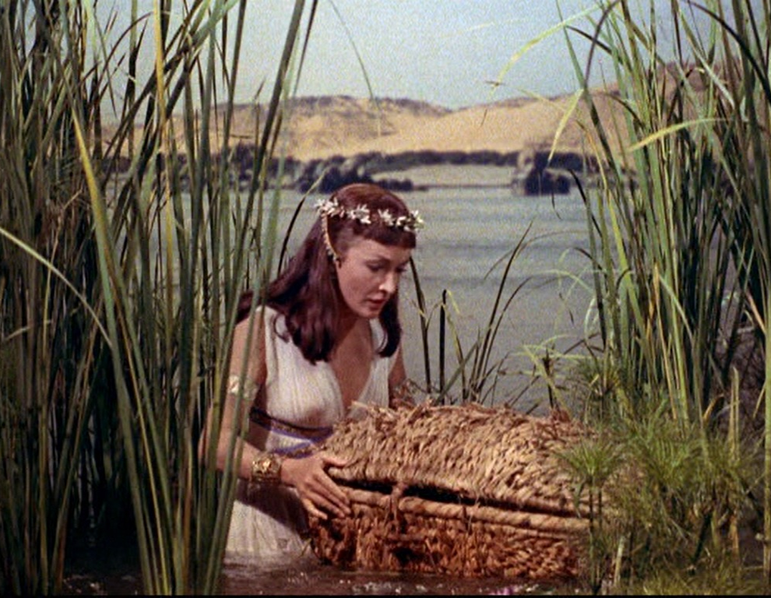
Introduction: From Abraham to Moses (Exodus 2-6)
A child called Moses was born. He was hidden by his mother, then later she put him in a waterproof basket and left him in the Nile river
The king’s daughter found Moses and adopted him as a son; he grew up to be a powerful and educated ruler in Egypt
Moses Discovered -from Movie Ten Commandments

Slide 7
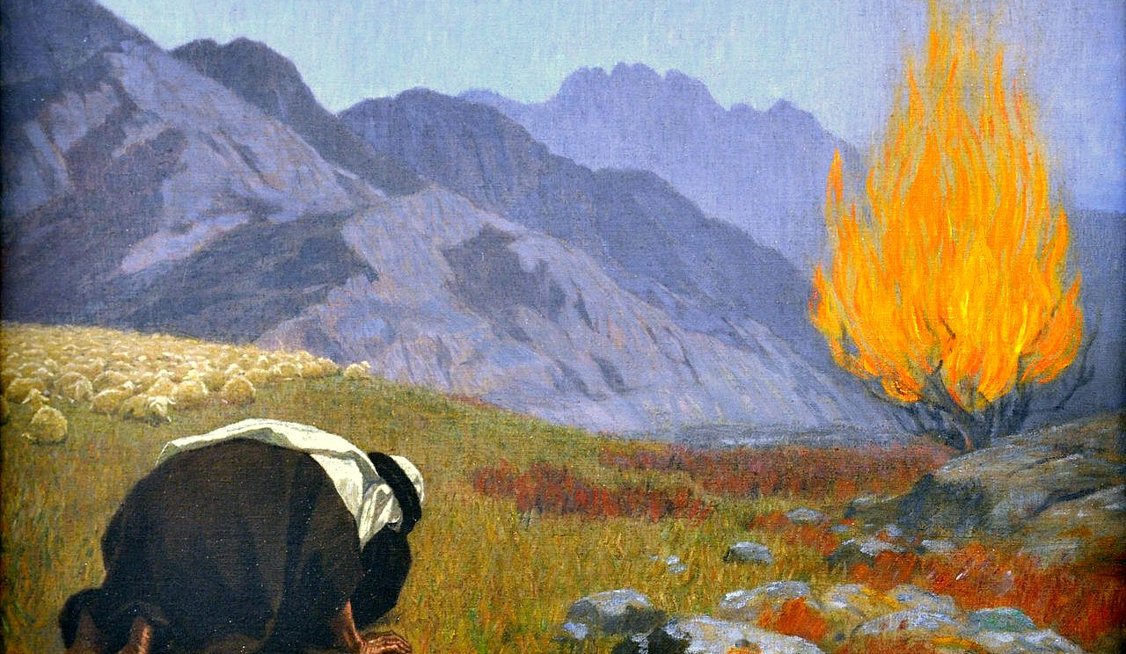
Introduction: From Abraham to Moses (Exodus 2-6)
Moses later killed an Egyptian who was beating an Israelite; then he escaped to the desert.
God met Moses in the desert and told him to go back to Egypt and perform miraculous signs for the Egyptian king, to rescue the Israelites from Egypt, and to lead them back to Canaan.
Moses Before the Burning Bush, by Gebhard Fugal

Slide 8
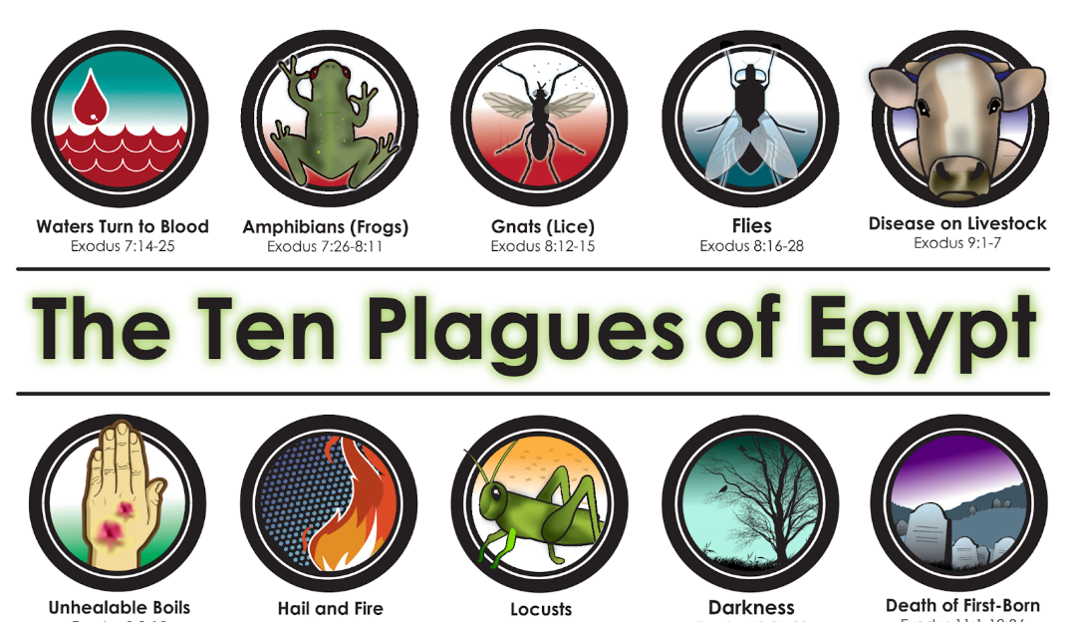
The 10 Plagues – Miraculous Signs from God (Exodus 7 - 12)
The Nile river turned to blood
Frogs
Gnats - small biting flies
Flies
Animal sickness
Boils - painful sores on skin
Hail
Locusts - swarms of grasshoppers
Darkness for three days
Death of the Firstborn (except for the Israelites)
Passover

Slide 9
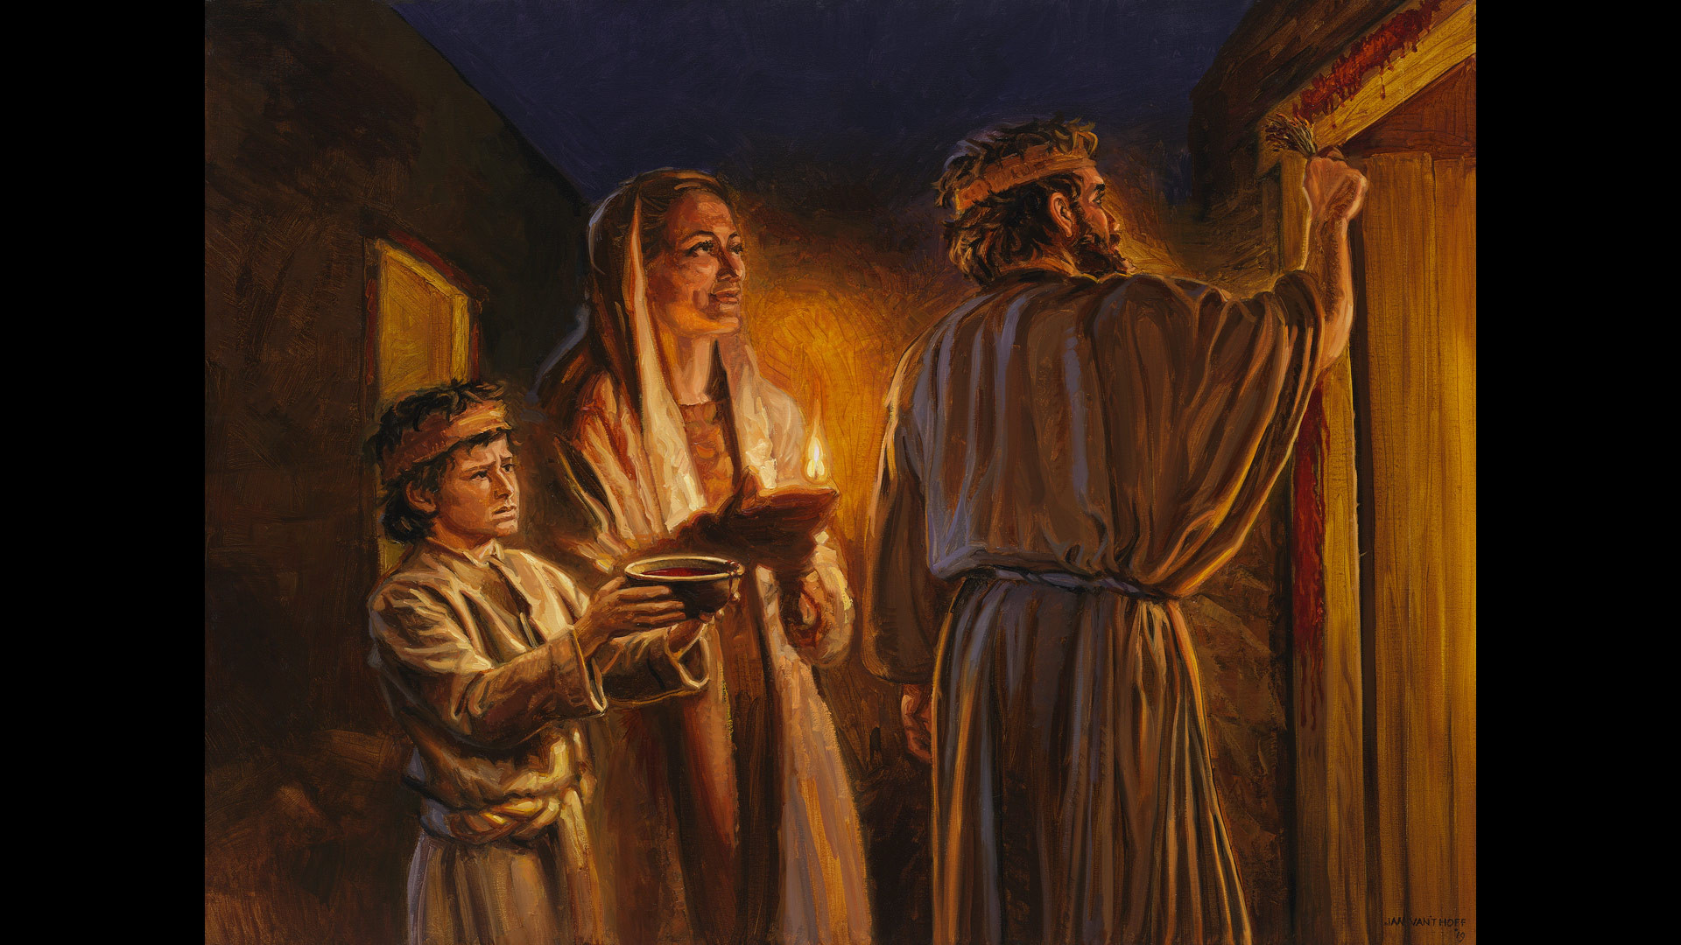
What was the Passover?
The Jewish people killed a lamb and sprinkled its blood on the doorposts.
The angel of death would then “pass over” that house.
The firstborn in every house that was not protected by the blood, died.
Jan van 't Hoff/Gospelimages.com

Slide 10
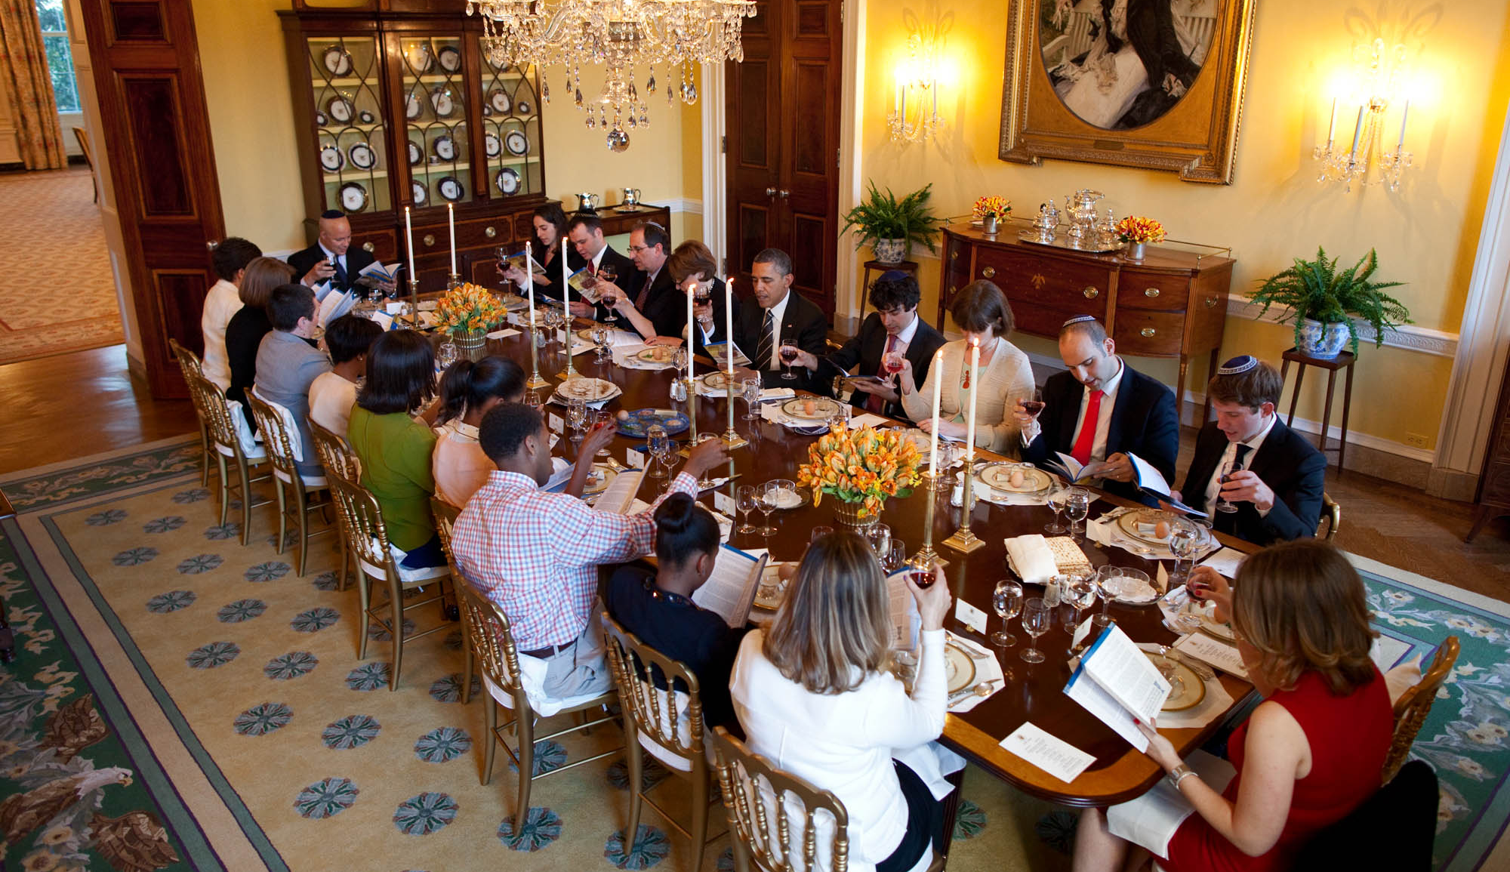
Is the Passover Still Celebrated?
Jews still celebrate the Passover today. Here is President Obama celebrating with Jewish people.
White House archives

Slide 11
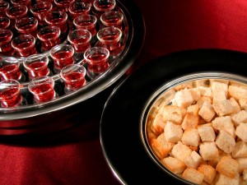
Do Christians celebrate the Passover?
No. Christians celebrate the “Lord’s Supper” or “Communion.”
However, this is a link. Jesus told Christians to do this when He celebrated the Passover the night before He died.

